Slide 1
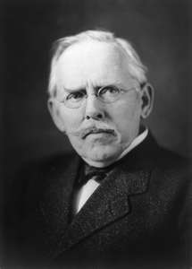
Jacob Riis Photos

Slide 2
Assignment
Directions- Get out a sheet of paper and number it 1-16.
I will be showing you 16 images from Jacob Riis’s Book, How The Other Half Lives.
Your assignment is to write down THREE details, for each photo, that show the ”New Immigrant” experience.

Slide 3
1. How the Other Half Lives

Slide 4
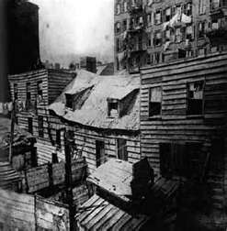
2

Slide 5
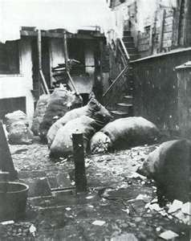
3. Alley

Slide 6
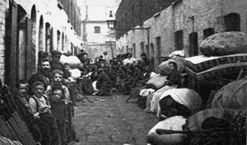
4

Slide 7
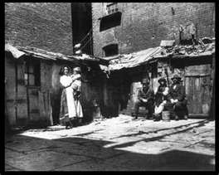
5

Slide 8
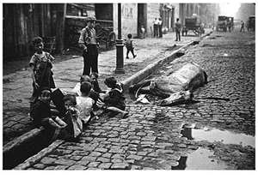
6

Slide 9
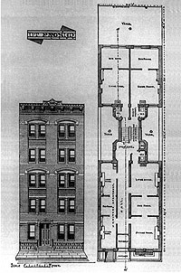
7

Slide 10
8

Slide 11
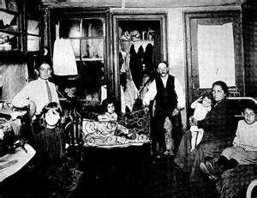
9

Slide 12
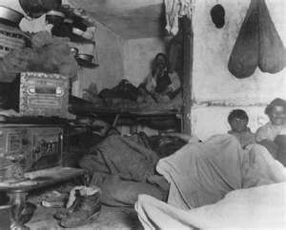
10

Slide 13
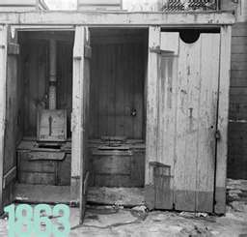
11.

Slide 14
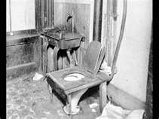
12

Slide 15
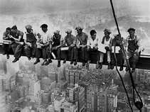
13

Slide 16
14

Slide 17
15. 1906 – SF Earthquake

Slide 18
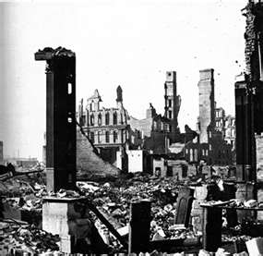
16. Chicago Fire

